Slide 1
Software testing techniques

Slide 2
Test Case Design
"Bugs lurk in corners
and congregate at
boundaries ..."
Boris Beizer
OBJECTIVE
to uncover errors
CRITERIA
in a complete manner
CONSTRAINT
with a minimum of effort and time

Slide 3
Exhaustive Testing
get(x)
for i := 1.. 20 loop
if F(x) then
...
else if G(x) then
...
else if H(x) then
...
else if M(x) then
...
else
N(x)
end if
get(x)
end loop
Suppose in developing a test plan for the code at the left, you decide to create a set of test cases that would allow you to execute all possible combinations of the branches for the 20 iterations of the for loop .
If it takes an average of 1 millisecond to execute a branch of the code (e.g., the instructions associated with the F(X) branch), how long will it take to run the test plan?
3780 years only!!!

Slide 4
Selective Testing
Selected path
loop < 20 X

Slide 5
Basic Path Testing
Basic Path Testing is a white box testing technique that consists of the following steps:
convert the unit into a “flow graph”
A flow graph is a directed graph (for an algorithm) with a "start node" and a "terminal node" (could have multiple terminal nodes, but not ideal).
compute a measure of the unit's logical complexity
use the measure to derive a “basic” set of execution paths for which test cases are determined.

Slide 6
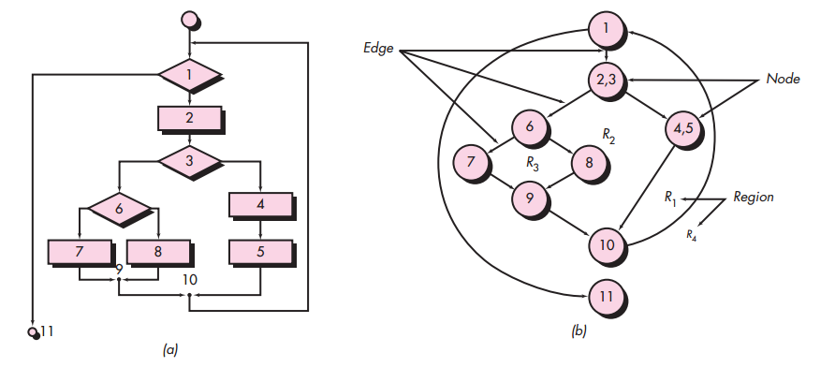
Flow graph examples

Slide 7
Cyclomatic Complexity
The cyclomatic complexity (McCabe complexity) is a metric, V(G), that describes the logical complexity of a flow graph, G. V(G) can be computed using any of the following formulae:
V(G) = E - N + 2
where E = number of edges in G and N = number of nodes in G
V(G) = R
where R = number of bounded regions in G
V(G) = P + 1
where P = number of predicates (num of decision nodes)
In this example V(G) = 4

Slide 8
Cyclomatic Complexity
A number of industry studies have indicated
that the higher V(G), the higher the probability
or errors.
modules
V(G)
modules in this range are
more error prone
V(G) = 10 is a practical upper limit for testing

Slide 9
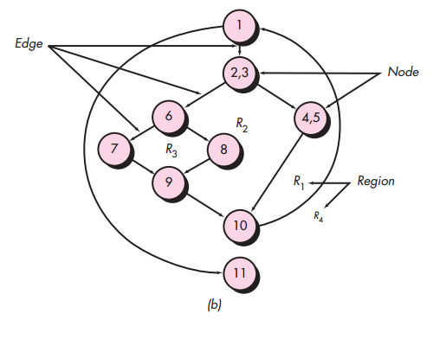
Independent Path Testing
Next, we derive the
independent paths:
Since V(G) = 4,
there are four paths
Path 1: 1-11 Path 2: 1-2-3-4-5-10-1-11 Path 3: 1-2-3-6-8-9-10-1-11 Path 4: 1-2-3-6-7-9-10-1-11
Finally, we derive test
cases to exercise these
paths.

Slide 10
Deriving Test Cases
Using the design or code as a foundation, draw a corresponding flow graph
Determine the cyclomatic complexity of the resultant flow graph
Determine a basis set of linearly independent paths
Prepare test cases that will force execution of each path in the basis set

Slide 11
Control Structure Testing
Condition testing — a test case design method that exercises the logical conditions contained in a program module
Data flow testing — selects test paths of a program according to the locations of definitions and uses of variables in the program

Slide 12
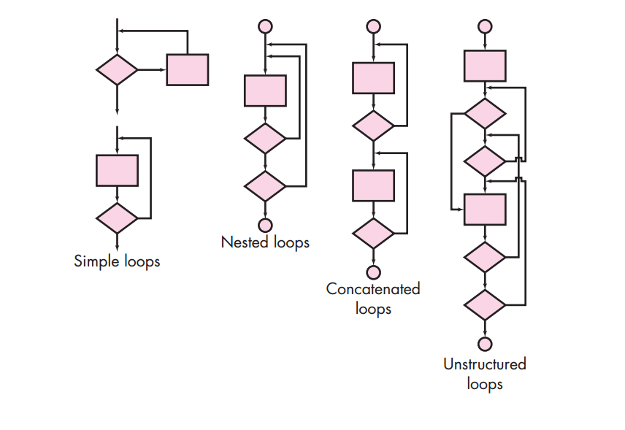
Loop testing

Slide 13
Loop Testing: Simple Loops
Minimum conditions—Simple Loops 1. skip the loop entirely 2. only one pass through the loop 3. two passes through the loop 4. m passes through the loop m < n 5. (n-1), n, and (n+1) passes through the loop
where n is the maximum number of allowable passes

Slide 14
Loop Testing: Nested Loops
Nested loops. 1. Start at the innermost loop. Set all other loops to minimum values. 2. Conduct simple loop tests for the innermost loop while holding the outer loops at their minimum iteration parameter (e.g., loop counter) values. Add other tests for out-of-range or excluded values. 3. Work outward, conducting tests for the next loop, but keeping all other outer loops at minimum values and other nested loops to “typical” values. 4. Continue until all loops have been tested
Concatenated loops:If the loops are independent of one another then treat each as a simple loop else* treat as nested loops endif* for example, the final loop counter value of loop 1 is used to initialize loop 2
Unstructured loops Whenever possible, this class of loops should be redesigned to reflect the use of the structured programming constructs

Slide 15
Equivalence Partitioning
user
queries
output
formats
FK
input
mouse
picks
data
prompts

Slide 16
Equivalence partitioning
Divides the input data of a software unit into partitions of equivalent data assuming that all the conditions in one partition will be treated in the same way by the software.
We need to test only one condition from each partition.
If one condition in a partition works, we assume all of the conditions in that partition will work, and so there is little point in testing any of these others.
Similarly, if one of the conditions in a partition does not work, then we assume that none of the conditions in that partition will work.

Slide 17
Equivalence partitioning(examples)
If an input condition specifies a range, one valid and two invalid equivalence classes are defined.
If an input condition requires a specific value, one valid and two invalid equivalence classes are defined.
If an input condition specifies a member of a set, one valid and one invalid equivalence class are defined.
If an input condition is Boolean, one valid and one invalid class are defined

Slide 18
Example Program
A savings account in a bank has a different rate of interest depending on the balance in the account. The rate chart is as following:
0.5% rate of interest is given if the balance in the account is in the range of $0 to $1000
0.75% rate of interest is given if the balance in the account is in the range of $1000 to $10000
1% rate of interest is given if the balance in the account is above $10000
Invalid data | Partition 2 | Partition 3 | Partition 4
Balance <0 | 0 ≤ Balance <1000 | 1000 ≤ Balance< 10000 | 10000 ≤ Balance
Interest = undefined | Interest = 0.5% | Interest = 0.75% | Interest = 1.0%

Slide 19
Boundary Value Analysis
More errors occur on the "boundary" of an input domain rather than on the "center".
Some strategies:
If an input condition specifies a range bounded by values a and b, test cases should be designed with values a and b and just above and just below a and b
If an input condition specifies a number of values, test cases should be developed that exercise the minimum and maximum numbers. Values just above and below minimum and maximum are also tested
Apply guidelines 1 and 2 to output conditions. For example, assume that a temperature versus pressure table is required as output from an engineering analysis program. Test cases should be designed to create an output report that produces the maximum (and minimum) allowable number of table entries
If internal program data structures have prescribed boundaries (e.g., a table has a defined limit of 100 entries), be certain to design a test case to exercise the data structure at its boundary

Slide 20
Boundary value analysis
Used to identify errors at boundaries rather than finding those exist in center of input domain.
Boundary value analysis complements and can be used in conjunction with equivalence partitioning.
Invalid data | Partition 2 | Partition 3 | Partition 4
Balance <0 | 0 ≤ Balance <1000 | 1000 ≤ Balance <10000 | 10000 ≤ Balance
Interest = undefined | Interest = 0.5% | Interest = 0.75% | Interest = 1.0%
-0.01, -2³¹ | 0, 0.01, 999.99 | 1000, 9999.99 | 10000, 2³¹-1

Slide 21
Positive testing
Positive testing validates that an application will work on giving valid input data.
Verifies that the application is NOT showing error when it is not supposed to
What is your phone number?
6184536032

Slide 22
Negative testing
Performed on the system by providing invalid data as input.
Checks whether an application behaves as expected with the negative input.
Ensures that your application can gracefully handle invalid input or unexpected user behavior.
What is your phone number?
xyZ#53()032

Slide 23
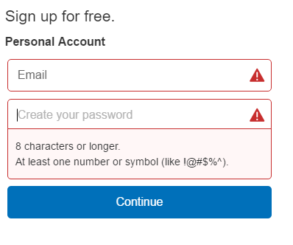
Typical Negative Testing Scenarios
Not populating required fields

Slide 24
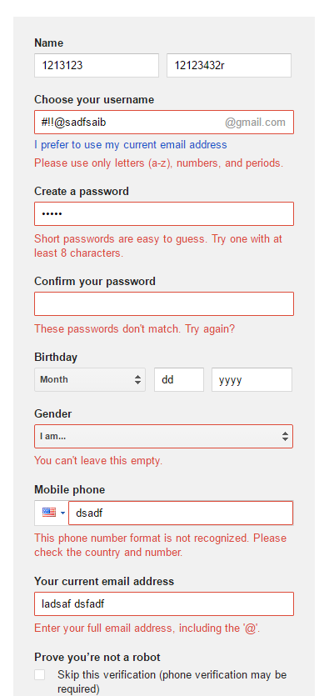
Correspondence between data and field types
Populating fields with incorrect data type

Slide 25
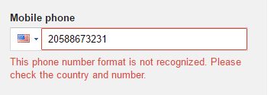
Allowed number of characters
Some applications or webpages may have set maximum / minimum values or number of characters for fields
Create a test that enters more characters into the field than is allowed.

Slide 26
Allowed data bounds and limits
Applications can use input fields that accept data in a certain range
Create a negative test that enters a value smaller than the lower bound or greater than the upper bound of the specified field
Please enter day?
-1
Please enter month?
13

Slide 27
Out of range values
Create test exceeding the bounds of the data types
Integer range:
-32,768 to 32,767 [2 bytes]
-2,147,483,648 to 2,147,483,647 [4 bytes]
Float range:
-3.4E+38 to +3.4E+38

Slide 28
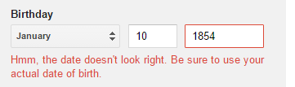
Reasonable data
Check application with unreasonable input data
Name with 300 characters
Human Age: 200 years

Slide 29

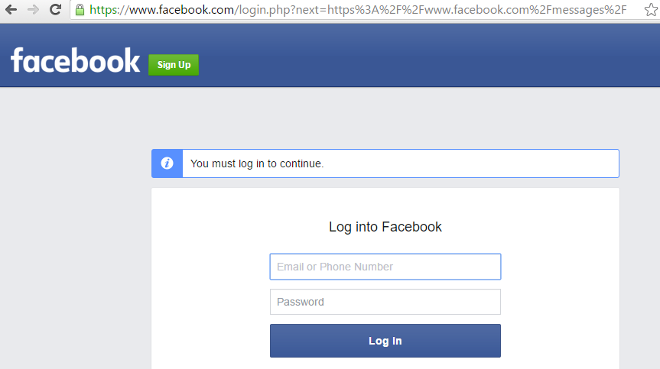
Web session testing
Can we access any URL without logging in?
Record some of the URL when you were logged in, try those again after you are logged out

